Slide 1
AWS-UCF PINN Research
UCF Team
Andre Von Zuben
Augusto Marques
Felipe Viana
AWS Team
Ankur Srivastava
Srinivas Tadepalli
Ana Simoes
Sundar Ranganathan
Ryan Qi
Adam Rasheed
Michael Curry

Slide 2
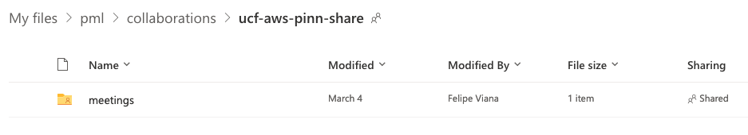
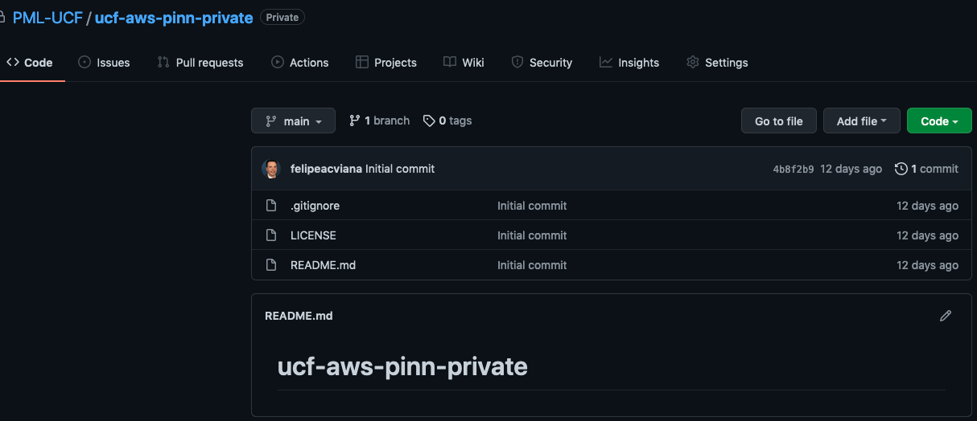
Logistics
UCF-AWS-PINN-SHARE on OneDrive
Shared with: aqsimoes@amazon.com; tadeps@amazon.com; mahaaws@amazon.com; rangasun@amazon.com; awsrashe@amazon.com; awsankur@amazon.com; ryanqi@amazon.com.
Anybody else?
GitHub repository
Could you send me your GitHub user information?

Slide 3

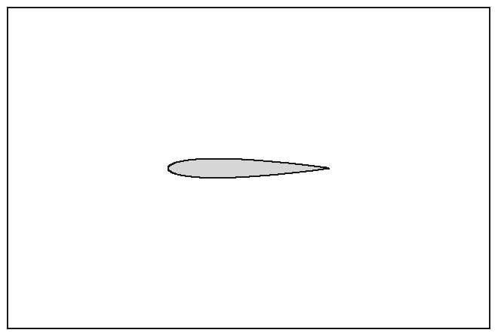
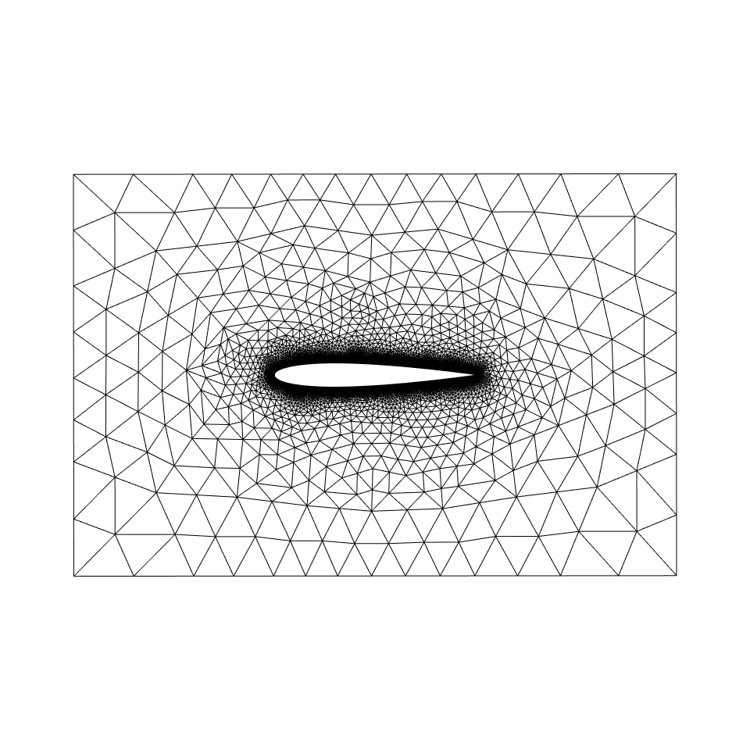


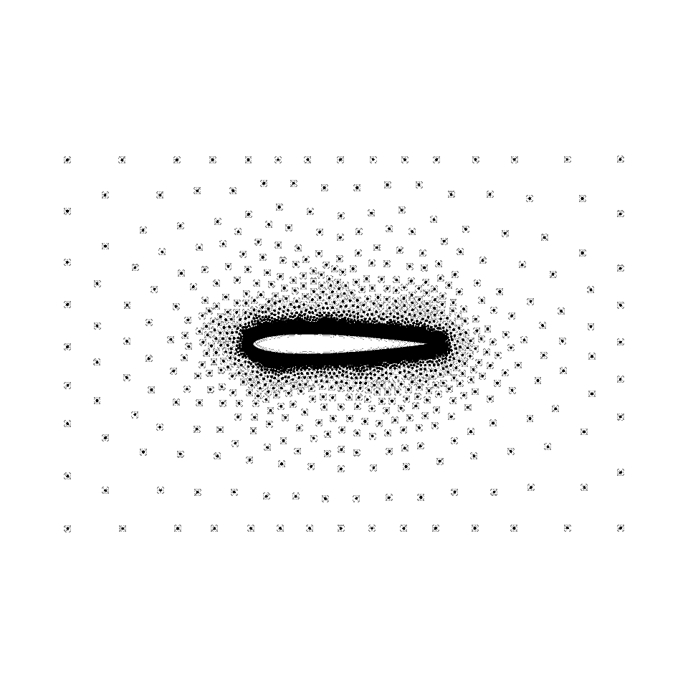
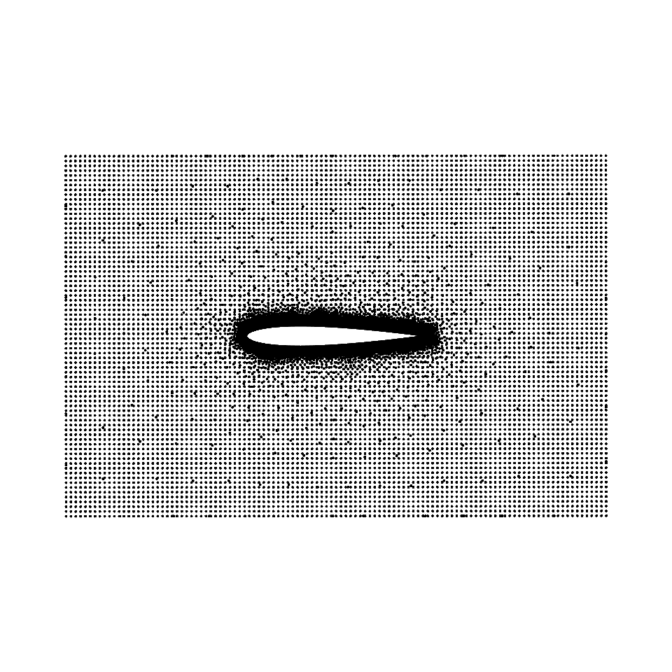
Proposed workflow
Third party
1) Generate geometry
Potential interface with other packages
Major hypothesis tested:
From geometry to collocation points: use engineering software (FreeCAD) and get baseline mesh, which defines problem through annotation. Densification can be applied if needed.
Split domain with specialized loss functions (equilibrium, initial condition, boundary conditions).
DDP implementation and deployment
Parametric modeling
Bulk of parallelization
Finished
2. Annotate equilibrium, BC, and material and generate baseline mesh
Almost finished
Current work
from mesh
densified
3) Generate file with collocation points
4) Customize (template) Python code for equilibrium, BC, and material
5) Generate solver setup files
6) Run solver

Slide 4
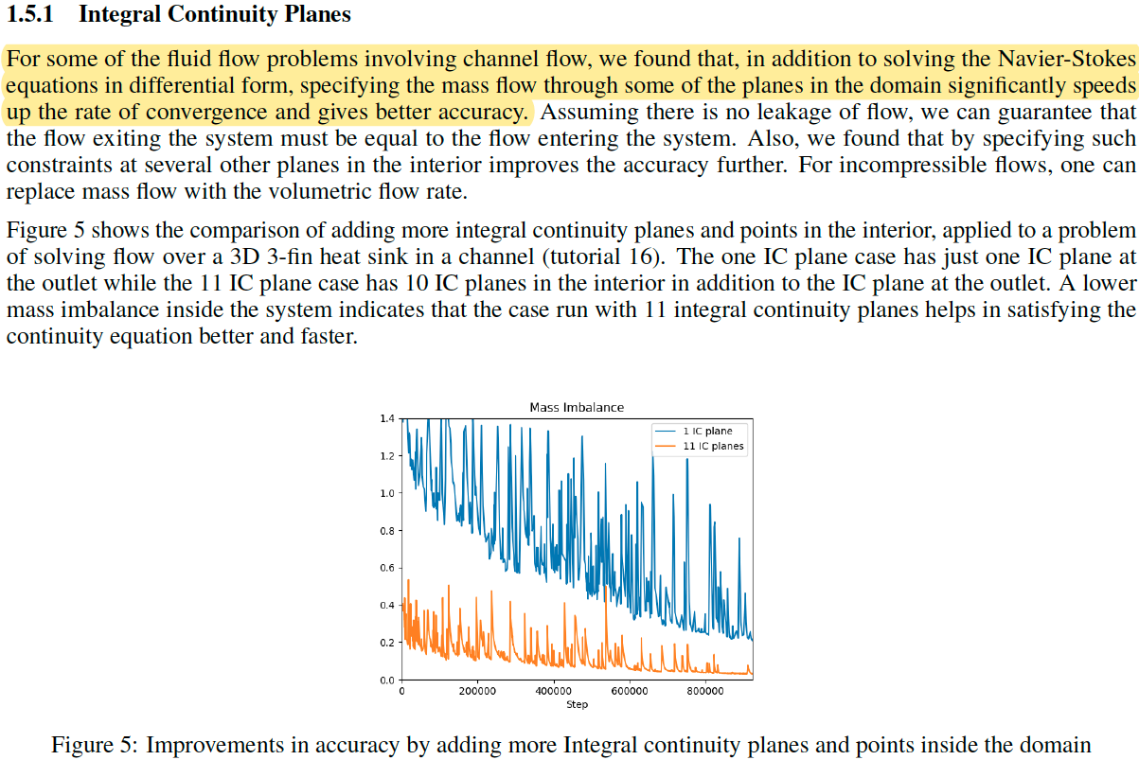
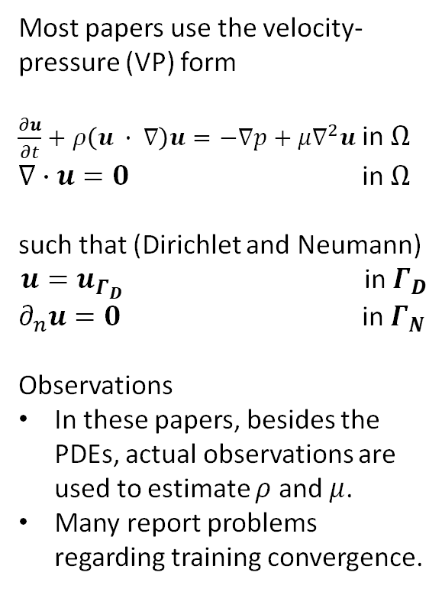
Navier-Stokes in the velocity-pressure (VP) form
(a) Approach to improve solution from Modulus (SimNet)
Most papers use the velocity-pressure (VP) form
$\frac{∂u}{∂t}+ρ\left(u ∙ ∇\right)u=−∇p+μ∇^{2}u$ in $Ω$
$∇∙u=0$ in $Ω$
such that (Dirichlet and Neumann)
$u=u_{Γ_{D}}$ in $Γ_{D}$
$∂_{n}u=0$ in $Γ_{N}$
Observations
In these papers, besides the PDEs, actual observations are used to estimate $ρ$ and $μ$.
Many report problems regarding training convergence.

Slide 5
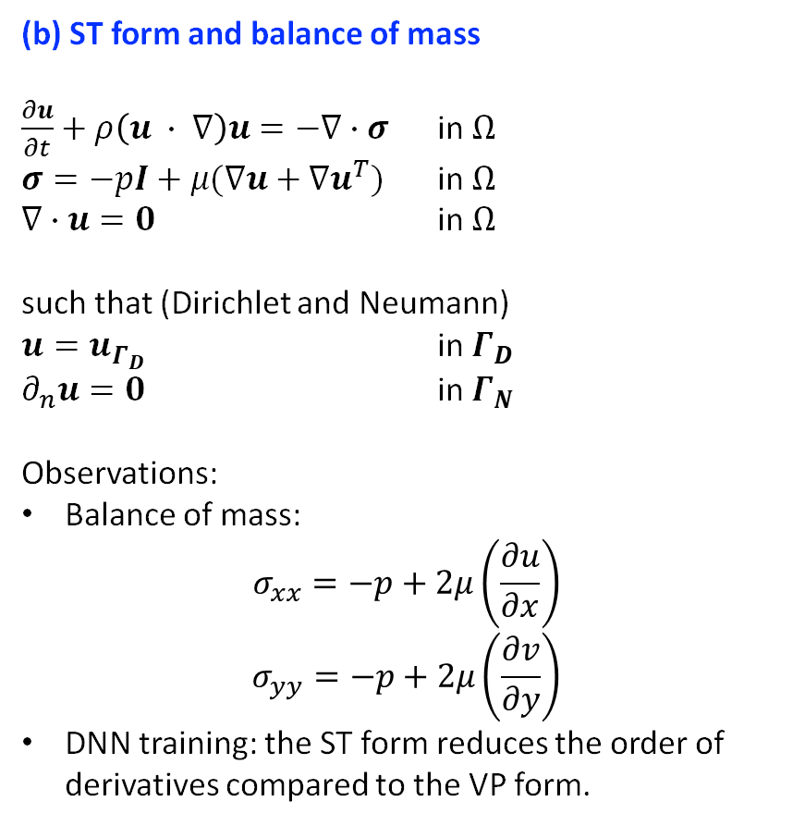
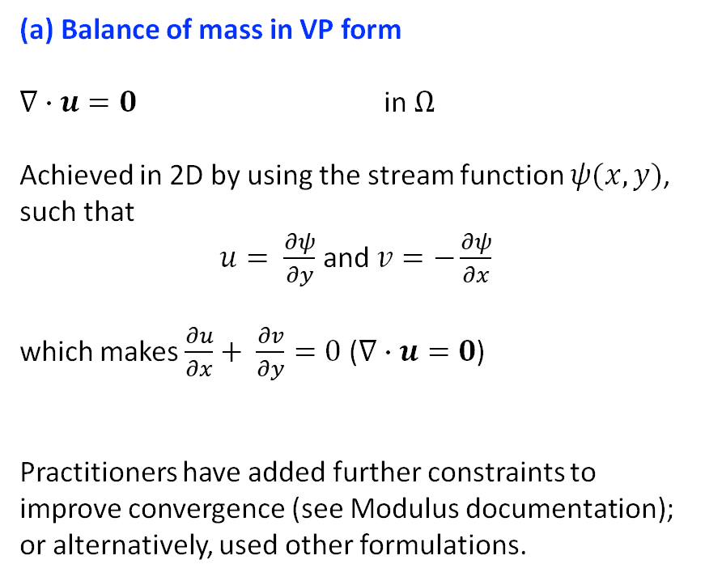
Navier-Stokes in the stress tensor (ST) form
(a) Balance of mass in VP form
$∇∙u=0$ in $Ω$
Achieved in 2D by using the stream function $ψ(x,y)$, such that
$u= \frac{∂ψ}{∂y}$ and $v=−\frac{∂ψ}{∂x}$
which makes $\frac{∂u}{∂x}+ \frac{∂v}{∂y}=0$ ($∇∙u=0$)
Practitioners have added further constraints to improve convergence (see Modulus documentation); or alternatively, used other formulations.
(b) ST form and balance of mass
$\frac{∂u}{∂t}+ρ\left(u ∙ ∇\right)u=−∇∙σ$ in $Ω$
$σ=−pI+μ(∇u+∇u^{T})$ in $Ω$
$∇∙u=0$ in $Ω$
such that (Dirichlet and Neumann)
$u=u_{Γ_{D}}$ in $Γ_{D}$
$∂_{n}u=0$ in $Γ_{N}$
Observations:
Balance of mass:
$$σ_{xx}=−p+2μ\left(\frac{∂u}{∂x}\right)$$
$$σ_{yy}=−p+2μ\left(\frac{∂v}{∂y}\right)$$
DNN training: the ST form reduces the order of derivatives compared to the VP form.

Slide 6
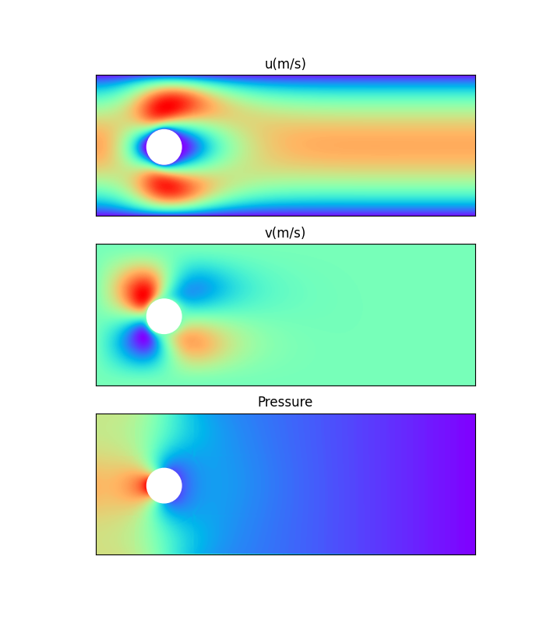
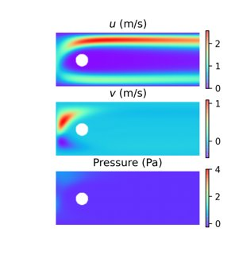
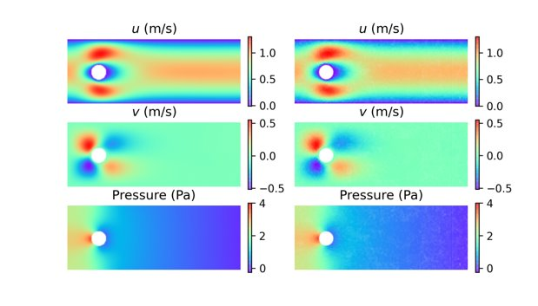
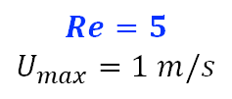
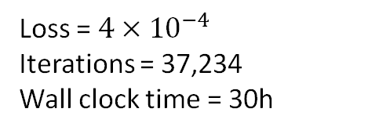
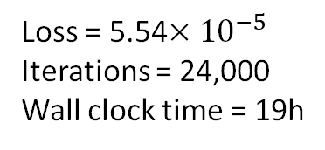
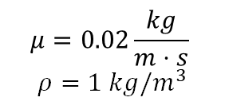
Laminar and steady state (explicitly making $\frac{∂u}{∂t}=0)$
(a) OpenFOAM
(b) VP formulation*
(c) ST formulation**
$$μ=0.02\frac{kg}{m⋅s}$$
$$ρ=1 kg/m^{3}$$
Loss = 5.54$×{10}^{−5}$
Iterations = 24,000
Wall clock time = 19h
Loss = $4×{10}^{−4}$
Iterations = 37,234
Wall clock time = 30h
$$Re=5$$
$$U_{max}=1 m/s$$
*Using our PyTorch implementation
**Using a TF1 implementation from Rao et al. (2020) (our implementation works the same)

Slide 7
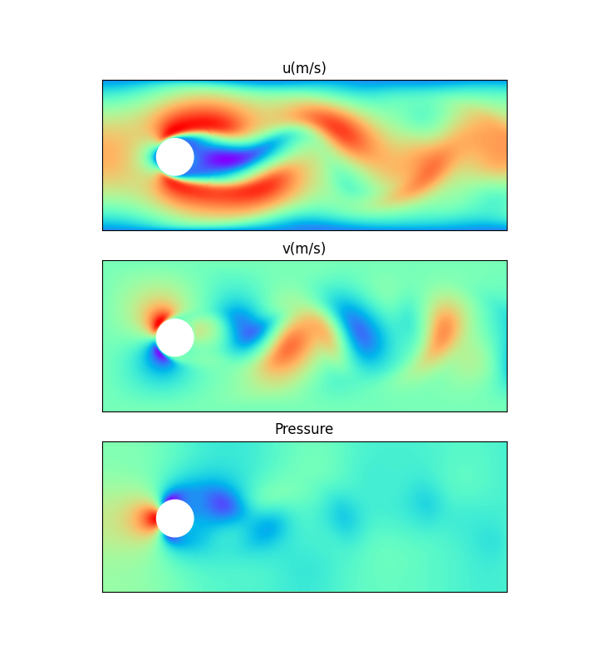
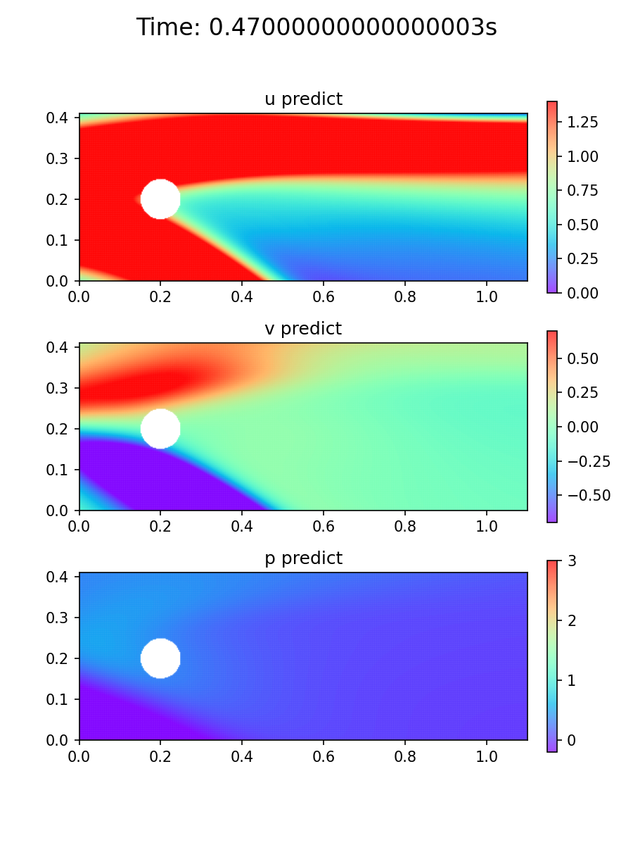
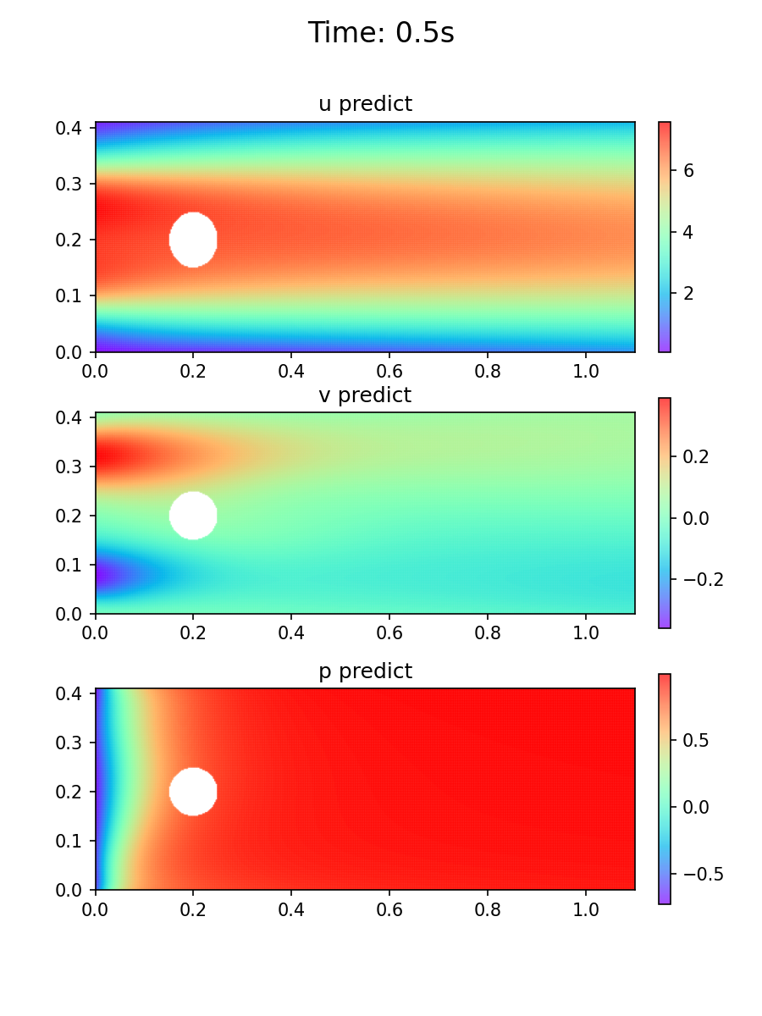
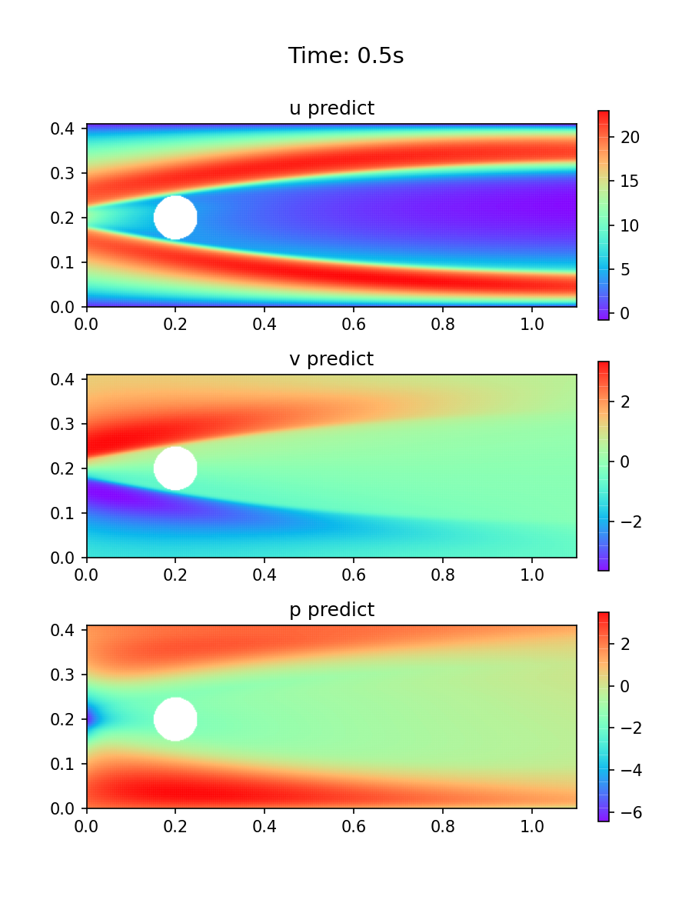
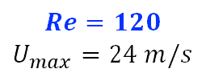
Transient and flow with mild Kalman vortexes
(a) OpenFOAM
(b) VP formulation*
(c) ST formulation**
$$μ=0.02\frac{kg}{m⋅s}$$
$$ρ=1 kg/m^{3}$$
Loss = 841
Iterations = 2300
Loss =264
Iterations = 35000
$$Re=120$$
$$U_{max}=24 m/s$$
*Using our PyTorch implementation
**Using a TF1 implementation from Rao et al. (2020) (our implementation works the same)

Slide 8
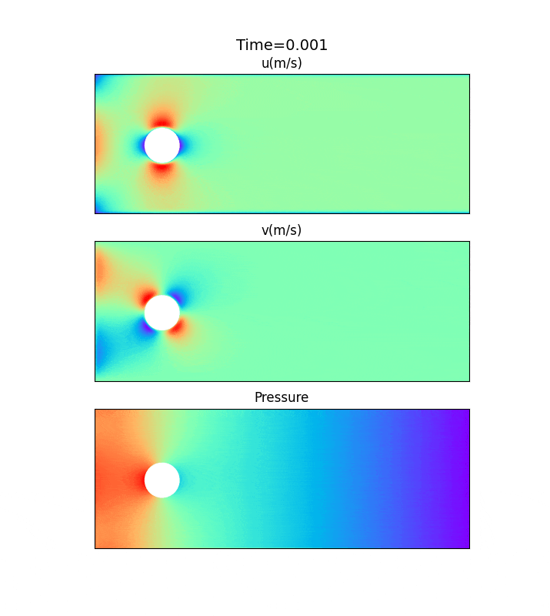
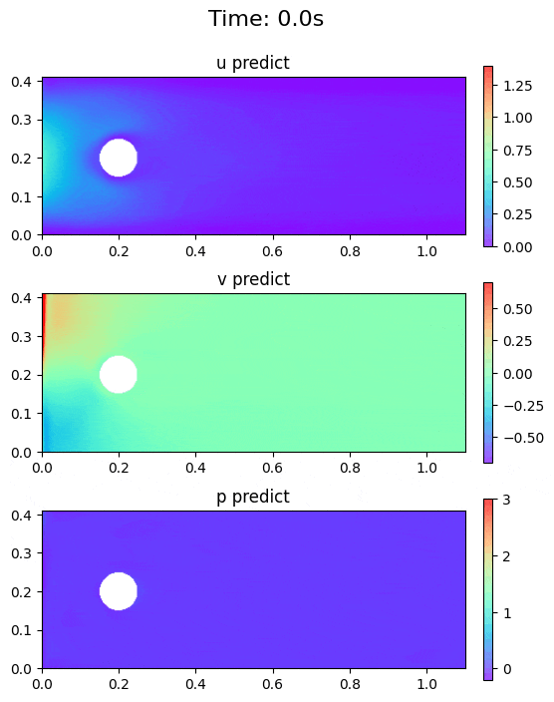
Transient and laminar flow
(a) OpenFOAM
(b) ST formulation
Incorporated ST formulation in our PyTorch implementation
PINN captures time-dependent response with realistic prediction
Optimization needs to be improved
GIF

Slide 9
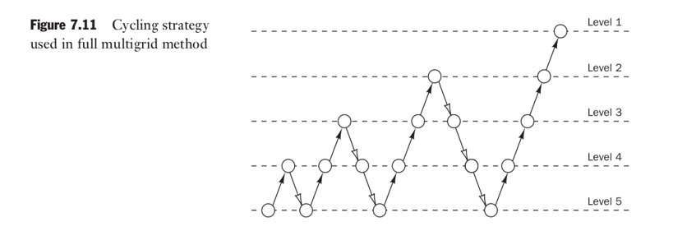
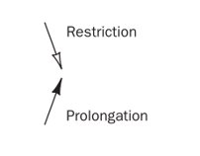
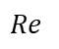
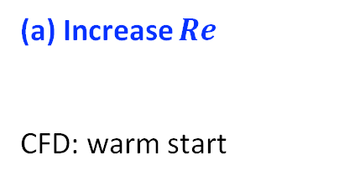
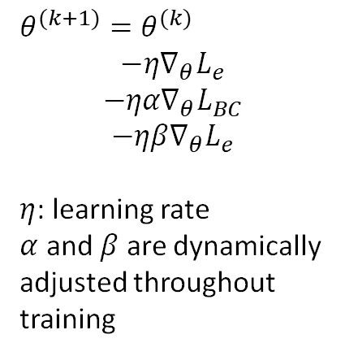
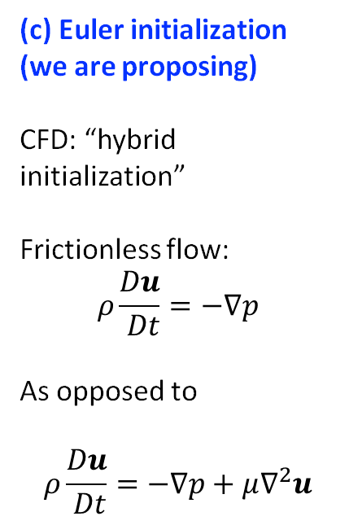
Improving PINN optimization
Literature has recognized need for specialized training schemes
(a) Increase $Re$
CFD: warm start
(b) Adaptive learning rate
CFD: --
(c) Euler initialization (we are proposing)
CFD: “hybrid initialization”
Frictionless flow:
$$ρ\frac{Du}{ Dt}=−∇p$$
As opposed to
$$ρ\frac{Du}{ Dt}=−∇p+μ∇^{2}u$$
(d) Vary collocation point density
CFD: multigrid
$$Re$$
$θ^{(k+1)}=θ^{(k)}$
$$−η∇_{θ}L_{e}$$
$$−ηα∇_{θ}L_{BC}$$
$$−ηβ∇_{θ}L_{e}$$
$η$: learning rate
$α$ and $β$ are dynamically adjusted throughout training
Level 1
Regular training
Warm start
Level 5
Iterations
https://proceedings.neurips.cc/paper/2021/file/df438e5206f31600e6ae4af72f2725f1-Paper.pdf
https://www.sciencedirect.com/science/article/pii/S0021999120307257
Versteeg, H. K., Malalasekera, W. (2007). An Introduction to Computational Fluid Dynamics: The Finite Volume Method.

Slide 10
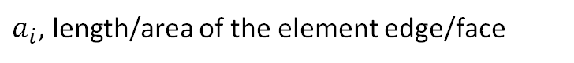
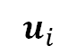
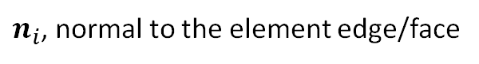
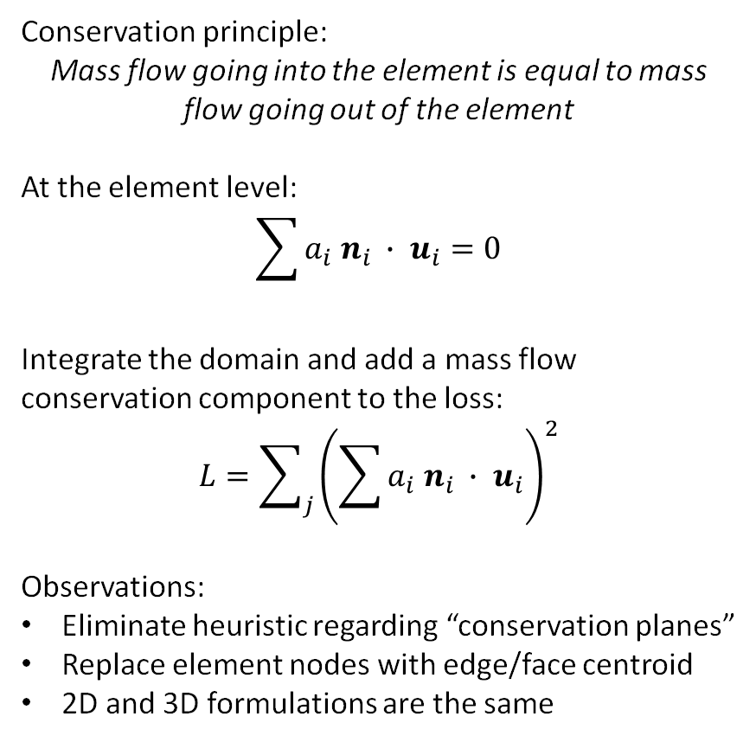
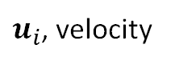
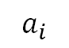
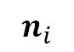
If mass balance continues to be a problem
Conservation principle:
Mass flow going into the element is equal to mass flow going out of the element
At the element level:
$$\sum{a_{i} n_{i} ∙ u_{i}}=0$$
Integrate the domain and add a mass flow conservation component to the loss:
$$L=\sum_{j}{{\left(\sum{a_{i} n_{i} ∙ u_{i}}\right)}^{2}}$$
Observations:
Eliminate heuristic regarding “conservation planes”
Replace element nodes with edge/face centroid
2D and 3D formulations are the same
$$u_{i}$$
$$n_{i}$$
$$a_{i}$$
Legend
Element
Node (collocation point)
$u_{i}$, velocity
$n_{i}$, normal to the element edge/face
$a_{i}$, length/area of the element edge/face

Slide 12
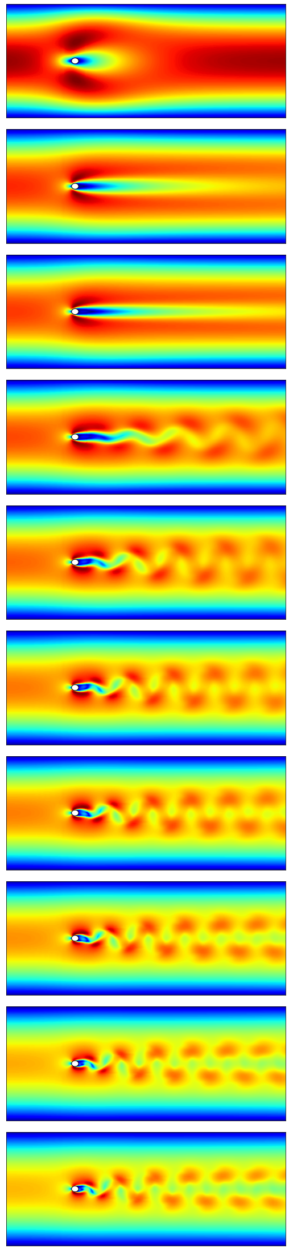

Slide 13
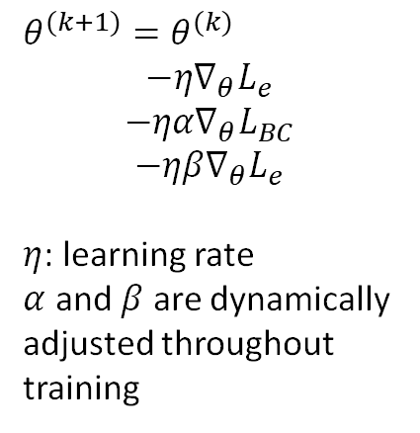

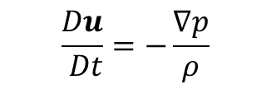
Needed improvement: training schemes
Literature has recognized need for specialized training schemes
(a) Vary collocation point density
CFD: multigrid
(b) Increase $Re$
CFD: warm start
(c) Adaptive learning rate
CFD: --
(d) Euler initialization (we propose)
CFD: hybrid initialization
$$Re$$
$θ^{(k+1)}=θ^{(k)}$
$$−η∇_{θ}L_{e}$$
$$−ηα∇_{θ}L_{BC}$$
$$−ηβ∇_{θ}L_{e}$$
$η$: learning rate
$α$ and $β$ are dynamically adjusted throughout training
Level 1
Regular training
$$\frac{Du}{ Dt}=−\frac{∇p}{ρ}$$
Warm start
Level 5
Starts with a frictionless flow
Iterations
Versteeg, H. K., Malalasekera, W. (2007). An Introduction to Computational Fluid Dynamics: The Finite Volume Method.
https://proceedings.neurips.cc/paper/2021/file/df438e5206f31600e6ae4af72f2725f1-Paper.pdf
https://www.sciencedirect.com/science/article/pii/S0021999120307257

Slide 14
Schedule
Month within the period of performance | Mar | Apr | May | Jun | Jul | Aug | Sep | Oct | Nov | Dec | Jan | Feb
Pre-processing routines
Read geometry files
Generate collocation points (mesh)
Processing routines
Implement PINN solver
Establish default parameters
Post-processing routines (visualization)
Generate standard files (for FE software)
Generate rendering routines
Verification and validation
Use agreed upon case studies
Skeleton of many routines (pre-processing and processing) in place
We will get into packaging them in classes and improve solver robustness (neural network initialization, handling collocation point and losses, optimizer, etc.)

Slide 15
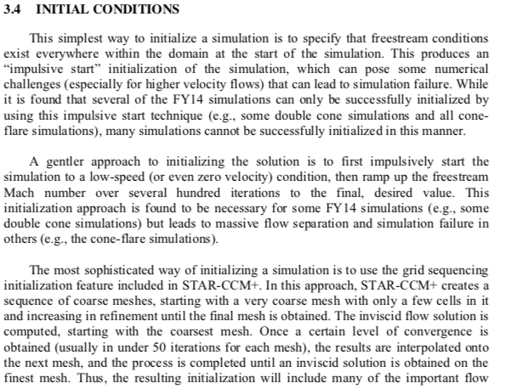
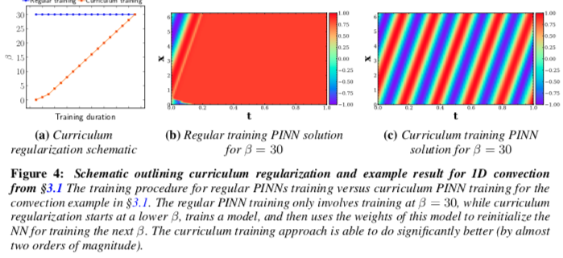
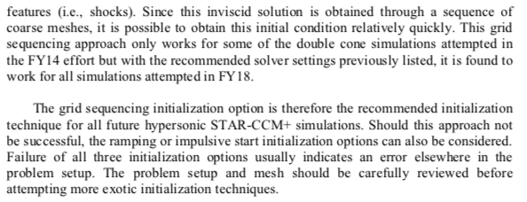
Neural net initialization idea (beg, borrow, steal)
https://apps.dtic.mil/sti/pdfs/AD1069198.pdf
https://proceedings.neurips.cc/paper/2021/file/df438e5206f31600e6ae4af72f2725f1-Paper.pdf

Slide 16
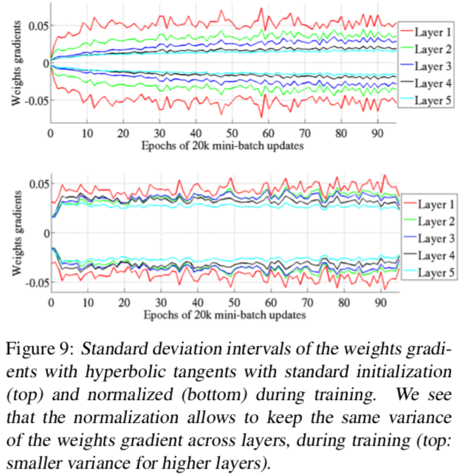
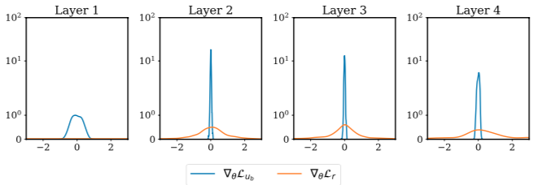
Tracking gradients
http://proceedings.mlr.press/v9/glorot10a/glorot10a.pdf
https://epubs.siam.org/doi/pdf/10.1137/20M1318043

Slide 17
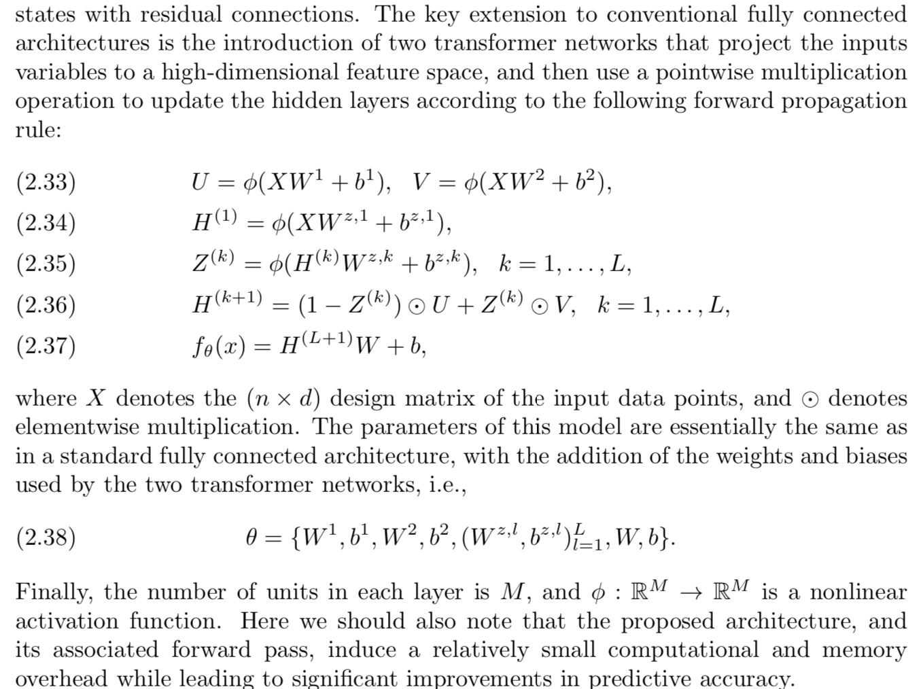
Architecture
https://epubs.siam.org/doi/pdf/10.1137/20M1318043

Slide 18
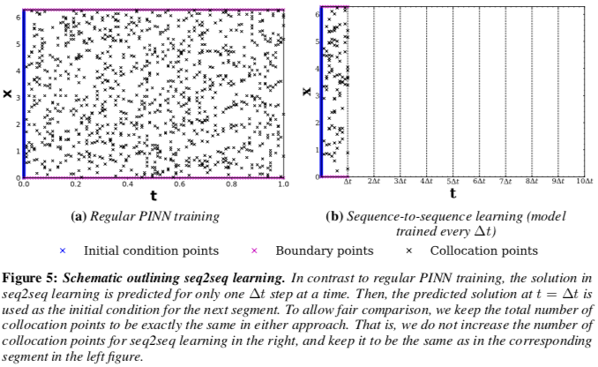
Dealing with time (beg, borrow, steal?)
https://proceedings.neurips.cc/paper/2021/file/df438e5206f31600e6ae4af72f2725f1-Paper.pdf

Slide 19
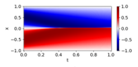
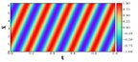
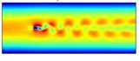


Study cases
Case​ |  | Ground truth​ | PINN (Vanilla and others)​ | ​
1D​ | ​ | Exact solution​ | ​ | ​
 | ​ | Exact solution​ | C-PINN​ | ​
2D​ | ​ | OpenFoam​ | ​ | ​
3D​ | ​ | FreeCad​ | Modulus​ | ​
 | ​ | OpenFoam​ | Modulus​ | ​
Burgers' equation
Convection equation
Flow around a cylinder
Deflection of a bracket
Flow in aneurysm

Slide 20
Draft and old

Slide 21


Estimating data size
Baseline cases (float32)
 | Steady-state |  | Transient
Collocation points | 1M |  | 1M
Time steps | 1 |  | 1,000
DOE size | 1 | 50 | 1 | 50
Data size | 12 MB | 600 MB | 12 GB | 600 GB
ImageNet = 150GB
English Wikipedia = 20.69 GB
c4/en = 866.42 GB
c4/multilingual = 29.42 TB

Slide 22
Distributed training (recap)
DOE points
Blindly breaking collocation points into processes (GPUs) might work for small problems, but it does not scale well with data
A major problem is the mix of collocation points coming from equilibrium, boundary conditions, and initial conditions.

Slide 23










New stochastic dynamic batching
1) Create DOE points:
2) Create h5 files:
3) Iterate over h5 files
4) Choose h5 files for next iterations
5) Go back to step 3 and repeat until convergence
h5 #1
Training
Validation
File
Probability
Fraction of or all IC from DOE#1
h5 #1
h5 #$n_{GPU}+1$
h5 #1
$$p_{1}$$
This scheme is computationally efficient:
h5 files have only one head, therefore only one dynamic graph executed within each the GPU
Probabilities are computed with losses as they are reduced and sent back to host process
No need to force convergence at IC/BC points since larger errors would drive higher losses and therefore higher probabilities in step 4
...
h5 #2
h5 #2
h5 #2
$$p_{2}$$
...
Fraction of or all BC from DOE#1
h5 #$n_{h5}$
h5 #$n_{GPU}$
h5 #3
$$p_{3}$$
h5 #3
Fraction of or all BC from DOE#1
Compute gradients for weights and biases
Update model parameters
Compute loss at all h5 files
h5 #4
$$p_{4}$$
...
h5 #4
h5 #$n_{h5}$
$$p_{n_{h5}}$$
Fraction of equilibrium from DOE#1
...
Probabilities are computed from (reduced) loss functions on a file-by-file basis
Probabilities are proportional to loss (higher losses are likely to be used as training again)
h5 #$n_{h5}$
Fraction of equilibrium from DOE#N
Each h5 file has only one head (computation efficiency)

Slide 24
To-do list
Augusto:
1) Find architecture from literature that works (preferably in PyTorch)
https://github.com/Raocp/PINN-laminar-flow
2) Cluster collocation points
3) Continuity collocation points with normal vectors
2D: collocation points = half-way between nodes for each element
3D: collocation points = barycenter of faces
Normal vectors saved as annotation within new continuity
3) Aneurism
Andre:
Implement h5 sampling algorithm -> 50 files (100 total) – 20 seconds; evaluation: 500 files (100 samples) – 32 seconds
Cluster collocation points
Andre and Augusto
Connectivity matrix trick for conservation of mass

Slide 25


Testing Navier Stokes implementation
Use case 1: Creeping flow
Reproduce
https://github.com/Raocp/PINN-laminar-flow
Use case 2: Flow with vortex shedding
Re = 62.9
Umax = 6.29 m/s
Run ground truth using OpenFoam
Ideally run original code (might have to create a new Python environment)
Run our PyTorch implementation with setup as similar as possible (don’t break down domain in multiple h5 files yet)
Run implementation with multiple h5 files
Run ground truth using OpenFoam
Ideally run “Raocp” code (might have to create a new Python environment)
Run our PyTorch implementation with setup as similar as possible (don’t break down domain in multiple h5 files yet)
Run implementation with multiple h5 files
TRY WITHOUT CONSERVATION OF MASS FIRST

Slide 26


Navier Stokes formulations
https://arc.aiaa.org/doi/abs/10.2514/6.2022-1436 (See OneDrive)

Slide 27


Slide 28
Old stuff

Slide 29





Test case: Burgers’ equation
(a) Baseline - traditional PINN implementation
(b) Stochastic dynamic batching (4 files / 4 proc)
h5 files
BC
Equilibrium (2 files)
IC
1
x
-1
0
t
1
Setup:
4 h5 files
1 IC (100), 1 BC (200), 2 Eq (5000 ea)
4 processes

Slide 30









Test with #points in Eq. > #points in IC and BC
#points: 100 IC – 200 BC – 10,000 Eq. / 8 h5 files: 2 IC (50 ea), 2 BC (100 ea), 4 Eq (2500 ea)
(a) 2 processes
(a) 6 processes
(a) 10 processes
(a) 20 processes

Slide 31










Test with #points in Eq. $\sim$ #points in IC and BC
#points: 1,600 IC – 1,600 BC – 6,400 Eq. / 96 h5 files – 16 IC (100 ea), 16 BC (100 ea), 64 Eq (100 ea)
(a) 10 processes
(a) 20 processes
(a) 50 processes
(a) 100 processes
(a) 200 processes

Slide 32
Navier-Stokes
Spatial points:
Inlet: 182 (1 h5)
Outlet: 182 (1 h5)
noSlip1: 362 (2 h5)
noSlip2: 240 (1 h5)
noSlip3: 362 (2 h5)
NavierStokes: 38,460
Time steps: 2501 (0 to 5 – 0.002 step size)
Total data points: 96,188,460
H5s
12,943 (1,000/10,000) – 18 min
999 (100,000) – 15 min
999 (100,000 – valid 100) – 37 sec
20 hours/500 iterations of 100 files

Slide 33



Transient fluid dynamics problem (Navier-Stokes)
10D
30D
20D
D = 0.1 m
Inlet velocity profile
$$u\left(0, y\right)=4\frac{U_{max}\left(H −y\right)y}{H^{2}}$$
1.5 ≤ Re ≤ 150
$Re =\frac{U_{max}D}{ν}$
2D Incompressible flow
Laminar flow

Slide 34




Dataset for performance comparison
Examples for $ν=0.01$
Re = 1.5
Umax =0.15 m/s
Re = 62.9
Umax =6.29 m/s
Re = 150
Umax =15 m/s

Slide 35

POD Implementation
The EZyRB Python package performs a proper orthogonal decomposition with SVD (NumPy) and interpolation with RBFInterpolator (SciPy)
The POD with Interpolation is built upon the numerical data obtained by the original model (in our case, OpenFoam)
https://github.com/mathLab/EZyRB

Slide 36




Parametric study of Umax (10 data points)
Training set
Testing set
0.15
OpenFoam
POD
U
Difference
ΔU (m/s)
4.05
RMSE = 3.74 e-3
4.3
Umax = 3.73
3.73
0.00
11.03
RMSE = 0.55
Umax (m/s)
0.0
Umax = 9.37
9.37
0.00
17.64
RMSE = 0.57
Umax = 13.98
13.98
-5
15.00
0.00
Training points
Testing points

Slide 37
Parametric study of Umax and nu (20 data points)

Slide 38





Dataset for performance comparison
Varying param | $$U_{max}$$ | $$ν$$ | Training points | Test points
$U_{max}$ ($m/s$) | [0.15 , 15] | 0.01 | 10 and 20 | 30
$ν$ ($m^{2}/s$) | 1 | [$6.6×{10}^{−4}$, $6.6×{10}^{−2}$] | 10 and 20 | 30
$U_{max}$ and $ν$ | [0.15 , 1.5] | [$1×{10}^{−3}$, $9×{10}^{−3}$] | 20 and 40 | 60
Examples for $ν=0.01$
Re = 1.5
Umax =0.15 m/s
Re = 67.5
Umax =6.75 m/s
Re = 150
Umax =15 m/s

Slide 39
Results: number of files and processes
Persistence of validation/training loss and dynamic batching
Flag dynamic batching
Scale number of h5 files
2 IC (50 ea), 2 BC (100 ea), 4 Eq (2500 ea) – 2 / 5 / 10 / 20 processes
16 IC (100 ea), 16 BC (100 ea), 64 Eq (100 ea) – 10 / 20 / 50 / 100 / 200 processes
2 IC (100 ea), 2 BC (200 ea), 4 Eq (1000 / 2500 / 5000 ea)
16 IC, 16 BC, 64 Eq (1000 / 2500 / 5000 ea) – 10 / 20 / 50 / 100 / 200 processes
Loss vs iteration
#files (IC, BC, Eq.) vs iteration

Slide 40
Results: number of files and processes (cont’d)
Andre (and Renato)

Slide 41

HOST
DataPartitioner
Scatter data
GPU 1
GPU 2
GPU 3
GPU N
PINN
Optimizer
PINN
Optimizer
PINN
Optimizer
PINN
Optimizer
All-reduce
$$L,∇L$$
GPU 1
GPU 2
GPU 3
GPU N
PINN
Optimizer
PINN
Optimizer
PINN
Optimizer
PINN
Optimizer

Slide 42










DOE points:
Next
Single-machine (cluster) multi-GPU
HOST
DataPartitioner
Optimizer
Scatter data
Broadcast
$W,b$
Gather/
Reduce
$L,∇L$
GPU 1
GPU 2
GPU 3
GPU N
PINN
PINN
PINN
PINN
$$L_{1}$$
$$∇L_{1}$$
$$L_{2}$$
$$∇L_{2}$$
$$L_{3}$$
$$∇L_{3}$$
$$L_{N}$$
$$∇L_{N}$$
Implementation based on the Distributed Data-Parallel Training (DDP) paradigm

Slide 43
Estimating data size
Baseline case
 | Steady-state |  | Transient
Collocation points | 1M |  | 1M
DOE size | 1 | 50 | 1 | 50
Time steps | 1 |  | 1,000
Data size |  |  | 12 GB | 60 GB
Baseline case : 1M collocation points, 50 doe points, 1,000 time steps, float32 =600 GB, float64=1,200 GB
ImageNet = 150GB, English Wikipedia = 20.69 GB, c4/en = 866.42 GB, c4/multilingual = 29.42 TB

Slide 44







Test case: Burgers’ equation
(a) Baseline - traditional PINN implementation
(b) Stochastic dynamic batching (4 files / 4 proc)
h5 files
BC
Equilibrium (2 files)
IC
1
x
-1
0
t
1
Setup:
4 h5 files
1 IC (100), 1 BC (200), 2 Eq (5000 ea)
4 processes

Slide 45












Test with #points in Eq. > #points in IC and BC
#points: 100 IC – 200 BC – 10,000 Eq. / 8 h5 files: 2 IC (50 ea), 2 BC (100 ea), 4 Eq (2500 ea)
(a) 2 processes
(a) 6 processes
(a) 10 processes
(a) 20 processes

Slide 46














Test with #points in Eq. $\sim$ #points in IC and BC
#points: 1,600 IC – 1,600 BC – 6,400 Eq. / 96 h5 files – 16 IC (100 ea), 16 BC (100 ea), 64 Eq (100 ea)
(a) 10 processes
(a) 20 processes
(a) 50 processes
(a) 100 processes
(a) 200 processes

Slide 47

From physics to classes
Physics
Classes
Burger’s equation:
$$\frac{∂u}{∂t}+u\frac{∂u}{∂x}−ν\frac{∂^{2}u}{∂x^{2}}=0,$$
subjected to:
$$u\left(t=0,x\right)=−A sin\left(πx\right)$$
$$u\left(t,x=±1\right)=0$$
$$−1≤x≤1, 0≤t≤1$$
where $ν$ is the viscosity
class Burgers(TrainingHead):
def __init__(self, theta) -> None:
super(Burgers, self).__init__()
self.theta = theta
def get_variables(self, inputs):
x = inputs[:, :1].requires_grad_()
t = inputs[:, 1:].requires_grad_()
variables = (x, t)
return torch.cat(variables, 1), variables
def forward(self, u, x, t):
u_x = torch.autograd.grad(u, x, ...)[0]
u_t = torch.autograd.grad(u, t, ...)[0]
u_xx = torch.autograd.grad(u_x, x, ...)[0]
f = u_t + u * u_x - self.theta * u_xx
return f
Annotation in vtk file
BurgersBC
Burgers
BurgersIC
1
x
-1
0
t
1

Slide 48
From physics to classes
Physics
Classes
Burger’s equation:
$$\frac{∂u}{∂t}+u\frac{∂u}{∂x}−ν\frac{∂^{2}u}{∂x^{2}}=0,$$
subjected to:
$$u\left(t=0,x\right)=−A sin\left(πx\right)$$
$$u\left(t,x=±1\right)=0$$
$$−1≤x≤1, 0≤t≤1$$
where $ν$ is the viscosity
class BurgersIC(TrainingHead):
def __init__(self, a) -> None:
super(BurgersIC, self).__init__()
self.a = a
def get_variables(self, inputs):
x = inputs[:, :1]
return inputs, (x, )
def forward(self, u, x):
return u - (-self.a * torch.sin(np.pi * x))
class BurgersBC(TrainingHead):
def __init__(self) -> None:
super(BurgersBC, self).__init__()
def get_variables(self, inputs):
return inputs, (inputs, )
def forward(self, u, variables):
return u
Annotation in vtk file
BurgersBC
Burgers
BurgersIC
1
x
-1
0
t
1

Slide 49
Snippets of code: PINNModel and Training loop
PINNModel
Model creation
class PINNModel(nn.Module):
def __init__(self, net, training_heads):
self.net = net
self.training_heads = training_heads
def forward(self, x, key):
head = self.training_heads[key]
x, variables = head.get_variables(x)
x = self.net(x)
x = head(x, *variables)
return x
net = Net()
training_heads = nn.ModuleDict({
'Burgers': Burgers(0.01 / np.pi),
'BurgersIC': BurgersIC(1),
'BurgersBC': BurgersBC(),
})
model = PINNModel(net, training_heads)
Training loop
for data, target in train_dataloader:
optimizer.zero_grad()
loss_eq = F.mse_loss(model(data, 'Burgers'), target)
loss_ic = F.mse_loss(model(ic_data, 'BurgersIC'), ic_target)
loss_bc = F.mse_loss(model(bc_data, 'BurgersBC'), bc_target)
loss = loss_eq + loss_ic + loss_bc
accelerator.backward(loss)
optimizer.step()
2 Nvidia Tesla P100 16GB
Training heads: 3 min 53 sec
Previous prototype: 3 min 18 sec
Local CPU (10x)
~ 13 min

Slide 50
Classes for Navier-Stokes 2D (incompressible)
class NavierStokes2D(TrainingHead):
def __init__(self, rho, mu, fx=0, fy=0) -> None:
super(NavierStokes2D, self).__init__()
self.rho = rho
self.fx = fx
self.fy = fy
self.mu = mu
def get_variables(self, inputs):
x = inputs[:, :1].requires_grad_()
y = inputs[:, 1:2].requires_grad_()
t = inputs[:, 2:].requires_grad_()
variables = (x, y, t)
return torch.cat(variables, 1), variables
def forward(self, psi_p, x, y, t):
psi = psi_p[:, :1] p = psi_p[:, 1:] u = torch.autograd.grad(psi, y, ...)[0]
.
.
mx = self.rho * (u_t + u*u_x + v*u_y) + p_x - self.rho*self.fx - self.mu *(u_xx + u_yy)
return u, v, mx, my

Slide 51
Classes for Navier-Stokes 2D (incompressible)
class VelocityBC(TrainingHead):
def __init__(self, u,v) -> None:
super(VelocityBC, self).__init__()
self.u = u
self.v = v
def get_variables(self, inputs):
x = inputs[:, :1].requires_grad_()
y = inputs[:, 1:2].requires_grad_()
t = inputs[:, 2:]
return torch.cat((x, y, t), 1), (x, y)
def forward(self, psi_p, x, y):
psi = psi_p[:, :1] p = psi_p[:, 1:]
u = torch.autograd.grad(psi, y,...)[0]
v = -torch.autograd.grad(psi, x,...)[0]
return u - self.u, v-self.v
class WallBC(TrainingHead):
def __init__(self) -> None:
super(WallBC, self).__init__()
def get_variables(self, inputs):
x = inputs[:, :1].requires_grad_()
y = inputs[:, 1:2].requires_grad_()
t = inputs[:, 2:]
return torch.cat((x, y, t), 1), (x, y)
def forward(self,psi_p, x, y):
psi = psi_p[:, :1]
p = psi_p[:, 1:]
u = torch.autograd.grad(psi, y,...)[0]
v = -torch.autograd.grad(psi, x,...)[0]
return u - torch.zeros_like(u),
v-torch.zeros_like(v)

Slide 52




Parametric modeling - Renato
$$L=L_{E}+(sign\left(L_{BC}−eps\right)+1)/2∗L_{BC}+(sign\left(L_{IC}−eps\right)+1)/2∗L_{IC}$$
Burger’s equation:
$$\frac{∂u}{∂t}+u\frac{∂u}{∂x}−ν\frac{∂^{2}u}{∂x^{2}}=0,$$
subjected to:
$$u\left(t=0,x\right)=−A sin\left(πx\right)$$
$$u\left(t,x=±1\right)=0$$
$$−1≤x≤1, 0≤t≤1$$
where $ν$ is the viscosity
Case study:
$$1≤A≤10$$
$$3.2×{10}^{−3}≤ν≤6.4×{10}^{−2}$$
Training vs validation
Propagation of uncertainty
$$1$$
$$−1$$

Slide 53
Navier Stokes - Augusto

Slide 54
DataLoader - Andre

Slide 55
Parametric models

Slide 56





Training
10,000 collocation points (from grid):
Boundary conditions
Initial conditions
1
x
-1
0
t
1
20 sampled values for density $ν$:
10
$$3.2×{10}^{−3}$$
$$6.4×{10}^{−2}$$
Prediction: 0.002 secs/instance of $ν$
Training:
10,000 epochs
4 hours (investigating issue, maybe installation)

Slide 57

















Validation
-1
+1
-1.75
-1.50
0.75
0
0.25
Velocity field
$$Δu=u_{p}−u_{sa}$$
Parametric
Stand alone
1
x
-1
0
t
1
$$6.4×{10}^{−2}$$
$$3.2×{10}^{−3}$$

Slide 58




Propagation of uncertainty
$$ν\sim N\left(μ,σ |ν>0\right)$$
$μ=0.017$ $σ=0.004$
Y = Net(cat((x,t,nu), dim=1))

Slide 59
Accelerate – handling different distributed settings

Slide 60
Why Accelerate
Easy API to make the same code run seamlessly on local machine or different distributed environments.
Original code (plain vanilla)
“Accelerate” version (DDP ready)
my_model.to(device)
for batch in my_dataloader:
my_optimizer.zero_grad()
inputs, targets = batch
inputs = inputs.to(device)
targets = targets.to(device)
outputs = my_model(inputs)
loss = my_loss_function(outputs, targets)
loss.backward()
my_optimizer.step()
from accelerate import Accelerator
accelerator = Accelerator()
device = accelerator.device
my_model.to(device)
my_model,my_optimizer,my_dataloader = accelerator.prepare(my_model,my_optimizer,my_dataloader)
for batch in my_dataloader:
my_optimizer.zero_grad()
inputs, targets = batch
inputs = inputs.to(device)
targets = targets.to(device)
outputs = my_model(inputs)
loss = my_loss_function(outputs, targets)
accelerator.backward(loss)
my_optimizer.step()
CLI tool that allows easy lauching:
$ accelerate launch my_script.py --args_to_my_script
Supported integrations: CPU only / single GPU multi-GPU on one node or several nodes / TPU / FP16 with native AMP

Slide 61
Snippets of code: Burgers’ equation
Implementation using Accelerate
def run(epochs=10, verbose=False):
accelerator = Accelerator()
...
train_dataloader = torch.utils.data.DataLoader(train_set, batch_size=bsz, shuffle=True)
train_bc_dataloader = torch.utils.data.DataLoader(train_set_bc, batch_size=bsz_bc,
shuffle=True)
model = Net()
model = model
optimizer = optim.Adam(model.parameters(), lr=0.002)
model, optimizer, train_dataloader, train_bc_dataloader = accelerator.prepare(
model, optimizer, train_dataloader, train_bc_dataloader)
...
for epoch range(epochs) :
...
for data in train_dataloader:
...
accelerator.backward(loss)
optimizer.step()
...

Slide 62
Snippets of code: Burgers’ equation
Implementation using Accelerate
...
if (epoch+1) % 10 == 0:
avg_loss = epoch_loss / num_batches
accelerator.reduce(avg_loss, 'mean')
accelerator.wait_for_everyone()
if accelerator.is_main_process:
if verbose:
print(f'Avg Loss at epoch {epoch}: {avg_loss}')
if avg_loss < best_loss:
if verbose:
print(f'Avg Loss improved from: {best_loss} to {avg_loss}')
best_loss = avg_loss
unwrapped_model = accelerator.unwrap_model(model)
accelerator.save(unwrapped_model.state_dict(), 'burgers_model.pt')
...

Slide 63


Snippets of code: Burgers’ equation
Accelerate config file for a 2-GPU Linux machine

Slide 64



Running on a 2-GPU Linux machine

Slide 65





Implementing distributed training – GPUs (Linux machine)
5000 Epochs, 2 Nvidia Tesla P100 16GB (3 min 18 secs)

Slide 66



Implementing distributed training – CPU (laptop)
5000 Epochs, 10 process, local CPU (~ 13 min)

Slide 67
Designing classes

Slide 68

Training Head
class Burgers(TrainingHead):
def __init__(self) -> None:
super(Burgers, self).__init__()
def forward(self, inputs, u):
x = inputs[:,:1]
t = inputs[:,1:2]
nu = inputs[:,2:]
u_x = torch.autograd.grad(u, x,
create_graph=True,
grad_outputs=torch.ones_like(x),
allow_unused=True)[0]
u_t = torch.autograd.grad(u, t,
create_graph=True,
grad_outputs=torch.ones_like(t),
allow_unused=True)[0]
u_xx = torch.autograd.grad(u_x, x,
create_graph=True,
grad_outputs=torch.ones_like(u_x),
allow_unused=True)[0]
f = u_t + u*u_x - nu*u_xx
return f

Slide 69
DataLoader
def get_partition(self, n=0, device=None):
points = {}
for bc in self.bcs:
nn = n % self.bcs[bc]['n_partitions']
if nn == self.bcs[bc]['n_partitions'] - 1:
points[bc] = self.bcs[bc]['points'][nn * self.bcs[bc]['partition_size']:]
else:
points[bc] = self.bcs[bc]['points'][nn * self.bcs[bc]['partition_size']:(nn + 1) * self.bcs[bc]['partition_size']]
return PINNDatasetPartition(points, self.variables, device)
PINNDataset
- n_partitions : int
- bcs : dict
- variables : list
+ PINNDataset(collocation_points, variables, …)
+ get_partition(n)
PINNDatasetPartition
- points : dict
- variables : list
- device : torch.device
Within the training loop:
for batch in my_dataloader:
my_optimizer.zero_grad()
inputs, targets, th_key = batch
training_head = training_heads[th_key]
...
+ PINNDatasetPartition(points, variables, …)
# __len__()
# __getitem__(index)
Compatible with PyTorch and Accelerate

Slide 70
Parametric models

Slide 71



Parametric modeling (Augusto)
Burger’s equation:
$$\frac{∂u}{∂t}+u\frac{∂u}{∂x}−ν\frac{∂^{2}u}{∂x^{2}}=0,$$
subjected to:
$$u\left(t=0,x\right)=−A\sin\left(πx\right)$$
$$u\left(t,x=±1\right)=0$$
$$−1≤x≤1, 0≤t≤1$$
where $ν$ is the viscosity and $A$ is the amplitude of the initial condition
Case study:
$$LOWER VALUE ≤ν≤ UPPER VALUE$$
$$LOWER VALUE ≤A≤ UPPER VALUE$$
Training vs validation
Propagation of uncertainty
$$A$$
$$−A$$

Slide 72
Training
DOE
GIF

Slide 73

Validation
Parametric
Stand alone
Difference
DOE
Blue – training
Black - validation

Slide 74

Propagation of uncertainty
$$ν,A\sim N\left(μ,Σ\right)$$
$$μ={\left[μ_{ν},μ_{A}\right]}^{T} Σ=\left[\begin{matrix}σ_{ν}^{2} & 0 \\ 0 & σ_{A}^{2}\end{matrix}\right]$$
$μ_{ν}=?$ $μ_{ν}=?$ $σ_{ν}^{2}=?$ $σ_{A}^{2}=?$
X= 0.5
0 <= T <= 1
Y=Net(cat([x,t,nu,A]))
-1 <= X <= 1
T= 0.75
X= 0.5
T= 0.5

Slide 75
Whiteboard
Things to consider:
Large computational mechanics models (FEA, CFD) can have meshes with millions of nodes.
Candidate classes:
PINNDataset: data set for our PINN (see next slide)
DistributedEnvironment: the objects could be instantiated using config files
DataPartitioner: this is what we have already started implementing.
For now, we want to be able to control the proportion of equilibrium only versus BC/IC points
We might want to give to users the freedom to split the data (training, test, validation)
Later, we should modify the training such that we are actually solving a constrained optimization problem
Architecture: any neural net, for now we have been using vanilla MLPs, but should be open to other architectures. Modulus has a rich collection of architectures.
DifferentialOperators: this should be NN heads added to PINN during training, they should be associated with equilibrium, boundary, and initial conditions.
PartialDifferentialEquations: this could be specialized set of differential operators for certain physics/engineering problems, such as: NavierStokes, LinearElasticity, etc. Modulus does a good job here.
LossScalingFactor: this class could be used to scale/normalize the loss associated with equilibrium, boundary, and initial conditions
Callbacks: we should/could use native PyTorch and that can come from config files (Logger, EarlyStopping, LearnRateScheduler, ReduceLROnPlateau, ModelCheckpoint, etc.). SciANN has a rich collection of Callbacks.
Solver (training): this could be interesting if we decide to wrap the optimization here. It could accommodate variations on the theme (DataPartitioner, Loss, etc.).
Solver (prediction): should also consider prediction loop that can be tied to different use cases, such as design optimization or uncertainty quantification.

Slide 76
TO DO
Points for discussion:
Implement ﻿burgers_ddp with “from torch.nn.parallel import DistributedDataParallel as DDP?”
Implementations:
From DOE file (csv or json) to ﻿torch.utils.data.Dataset
Can/should create a class for this (PINNDataset)
Each collocation point should have: inputs, targets, heads, losses
Inputs: need to figure how to stack xyzt with user-defined variables
Mesh and DOE without duplication during loading
Duplication happens when passing to workers
Targets: some DOE points might have results from FEA or CFD (need to figure out how to stuff that in the file system (e.g., /data_trng/data_01.vtk also has the ground truth)
Differential operators (PINNHead) and losses: together as a neural network head (nn.Module) indexed per collocation point so that “DataSplitter” can return the tuple.
Head: set of DifferentialOperators or PartialDifferentialEquations all dependent on the annotations in the vtk file (for now, a DOE point either has a target or a set of heads)
Losses: for now a lot will be MSE, but we should make it flexible. A collocation point might have more than one head when it belongs to BCs/ICs (one loss for the equilibrium and another for the BCs/ICs).
PINNHead:
forward(): user implements physics
loss(): default MSE.
PINN:
Differentiate between
forward(self, inputs): plain vanilla from inputs through field prediction
forward(self, PINNDataset): from inputs through field prediction and heads
Or have PINNEquilibrium / PINNDirichlet/etc...
Burgers with variable amplitude (or frequency)
Any further study on HuggingFace’s Accelerate?

Slide 77
TO DO
Andre:
Install PyTorch (cuda env.) on Alan
Run Accelerate version of burgers_ddp.py on Alan
PINNDataset
Renato:
Run Accelerate version of burgers_ddp.py somewhere else (multiple GPUs and TPU-colab)
Augusto:
Run burgers with A and nu as input variables (use burgers_ddp.py)
PINNHead:
Mother class
Child classes:
class Burgers(PINNHead)
class InitialCondition(PINNHead)
class BoundaryCondition(PINNHead)
Implement Burgers and if time allows Navier Stokes

Slide 78

Few classes in SciANN
Problem: Equilibrium and BCs are evaluated at ALL collocation points (BC loss is defined in terms of masks). This is simple to implement but inefficient as $n_{EQ} >> n_{BC}$.

Slide 79




Few classes in Modulus/SimNet

Slide 80
Collocation point densification
Before
vedo
Supports only a few mesh types (PolyData)
No annotations
Can’t read annotations from files
Point cloud densification
Points out of bounds
Points randomly created within a predefined radius
Now
PyVista
Supports several mesh types
Compatible with vedo
Annotations
Reads annotations from files
Preserve annotations during mesh refinement
Mesh subdivision
All points inside geometry
Points created alongside mesh edges

Slide 81






Collocation point densification (2D)
Original
Densified – max edge length: 0.05
Densified – max edge length: 0.02
Points: 5354
Points: 8262
Points: 42558
Execution time: 13.0s (8 CPUs)
Execution time: 22.7s (8 CPUs)

Slide 82




Collocation point densification (3D)
Original
Densified - Default
Points: 461122
Points: 2354
Execution time: 85.4s (8 CPUs)

Slide 83
Distributed training (single-machine multi-GPU)
HOST
DataPartitioner
Scatter data
GPU 1
GPU 2
GPU 3
GPU N
PINN
Optimizer
PINN
Optimizer
PINN
Optimizer
PINN
Optimizer
All-reduce
$$L,∇L$$
GPU 1
GPU 2
GPU 3
GPU N
PINN
Optimizer
PINN
Optimizer
PINN
Optimizer
PINN
Optimizer

Slide 84



Use case: Burgers’ equation
Solution with SciANN (TensorFlow)
5000 Epochs, Google Colab (GPU), 2 hours
Burger’s equation:
$$\frac{∂u}{∂t}+u\frac{∂u}{∂x}−ν\frac{∂^{2}u}{∂x^{2}}=0,$$
subjected to:
$$u\left(t=0,x\right)=−\sin\left(πx\right)$$
$$u\left(t,x=±1\right)=0$$
$$−1≤x≤1, 0≤t≤1$$
where $ν=0.01/π$
https://github.com/sciann/sciann-applications/blob/master/SciANN-BurgersEquation/SciANN-BurgersEquation.ipynb

Slide 85

Implementing distributed training
Distributed process
Colocation points
Equation: 10000 (grid)
BC:
Upper/Lower: 1000
Initial: 2000
rank 0
rank N
Partition 0
Slice of Eq. set
Slice of BC set
Model
NN graph
Partition N
Slice of Eq. set
Slice of BC set
training loop
training loop
for epoch in range(TOTAL_EPOCHS):
for minibatch in Eq.set:
Forward pass <Eq.Set minibatch>
Forward pass <entire Slice of BC.Set>
Loss = Loss_Eq + Loss_BC
loss.backward()
average_gradients()
(…)
DataPartitioner
Partitions
Slice of Eq.set
Slice of BC.set
All-reduce
average_gradients()
Optimizer
.step()
Optimizer
.step()
For N=10 parallel process:
Eq.set = 1000 pts
BC.set = 400 pts

Slide 86
Implementing distributed training
5000 Epochs, 10 process, local CPU (~ 13 min)

Slide 87








Next use case: 2D laminar flow (steady state)
Coarse mesh
Fine mesh
Inlet velocity profile
$$u\left(0, y\right)=4\frac{U_{max}\left(H −y\right)y}{H^{2}}$$
0.533
Umax = 0.5 m/s
Re = 992
1e-6
1.09
Umax = 1 m/s
Re = 1985
1e-6

Slide 88

File system and configuration setup (draft)
./project_name
/cad
my_doe.json
my_cad_01.brep
my_cad_01.msh
my_cad_02.brep
my_cad_02.msh
…
/data_trng
userLib.py
data_01.vtk
data_02.vtk
…
/pinn
config.trng
config.pred
model.pt (trained model)
…
/predictions
run_01.vtk
run_02.vtk
…
my_doe.json
Augusto (10 points):
fixed geometry (only Umax),
Parametrized geometry
Andre:
Export densified (collocation) *.vtk (shaft, airfoil, airfoil doe)
userLib.py
class Inlet(PDE):
def __init__(self, ...):
...
def forward(self, ...):

Slide 89







From geometry to visualization of results
Third party
Potential interface with other packages
Bulk of parallelization
Computational mechanics
1) Geometry
2) Mesh
3) Governing equations
4) Material formulation
5) Boundary conditions
6) Solver
7) Post-processing
PDEs:
Fluid dynamics
Heat transfer
Elasticity
Material properties
Constants
Varying properties
Temperatures, pressures, forces, displacements, etc.
Find solution of PDEs at domain of interest
$Δt$ is usually defined here
3D modeling (primitives, transformations, parametrization, etc.)
Mesh geometrical model or import it from a different application.
“PINN jargon”
Train PINN model
Pick NN architecture
Define loss function
Run optimizer
Predictions with trained PINN model
Dirichlet: $y\left(x,t\right)=f_{D}$
Neuman: $\frac{∂y}{∂x}\left(x,t\right)=f_{N}$
Robin: $c_{0}y\left(x,t\right)+c_{i}\frac{∂y\left(x,t\right)}{∂x}=f_{R}$
Others
Sample domain (space)
$$\frac{∂y}{∂t}=−y\frac{∂y}{∂x}+θ\frac{∂^{2}y}{∂x^{2}}$$
Model for $θ$
Our project
AWS-UCF-PINN:
Use FreeCAD
Alternatives:
Fusion360, Inventor, SolidEdge, etc.
AWS-UCF-PINN:
FreeCAD / GMesh
Alternatives:
Most FEA or CFD packages offer it
AWS-UCF-PINN:
We will design a metafile system (similar to scripts used by other computational mechanics packages).
This is where libraries such as Vedo will be used
Training vs prediction as well as solver configurations can be defined through a file system
AWS-UCF-PINN: Generate results compatible with ParaView
Alternatives:
Most FEA or CFD packages offer it

Slide 90


PINN 101
Computational mechanics
Finite element modeling
Computational fluid dynamics
Physics-informed neural networks

Slide 91
Reading
PyTorch stuff
https://github.com/pytorch/pytorch/tree/master/torch
https://pytorch.org/tutorials/beginner/dist_overview.html
https://pytorch.org/tutorials/intermediate/dist_tuto.html
https://pytorch.org/tutorials/intermediate/ddp_tutorial.html
https://pytorch.org/docs/stable/generated/torch.nn.parallel.DistributedDataParallel.html
General stuff
https://hydra.cc/
https://github.com/qd-cae/awesome-CAE
https://www.freecadweb.org/features.php

Slide 92
File system and configuration setup (draft)
./project_name
/cad
inlet.csv
my_cad_01.brep
my_cad_01.msh
my_cad_02.brep
my_cad_02.msh
…
/data_trng
userLib.py
data_01.vtk
data_02.vtk
…
/pinn
config.trng
config.pred
model.pt (trained model)
…
/predictions
run_01.vtk
run_02.vtk
…
Observations:
data_*.vtk:
Collocation points, equilibrium, and boundary conditions
Always needed and should be obtained through a code that reads the originally annotated brep and msh files. This code can eventually do sanity checks regarding the physics.
Saving vtk files allow users to perform cross-checks before dispatching time-consuming training/predictions.
Tag using engineering jargon (inlet, no slip, etc.) as opposed to math jargon (Dirichlet, Neuman, etc.)?
config.trng: configuration file for a “training job”
Neural network architecture / Optimizer setup / Loss function details / Data generator setup (splitting/batching of collocation points) / Execution setup (1. single-device / 2. single-machine multi-GPU)
A “super-user” could bypass by using our API directly (somewhat similarly to packages such Modulus).
config.pred: configuration file for a “prediction job”
File with trained model (model.pt) / Data generator setup (splitting/batching of collocation points) / Execution setup
Set of data_*.vtk files

Slide 93
Single-machine multi-GPU
HOST
DataPartitioner
Scatter data
GPU 1
GPU 2
GPU 3
GPU N
PINN
Optimizer
PINN
Optimizer
PINN
Optimizer
PINN
Optimizer
All-reduce
$$L,∇L$$
GPU 1
GPU 2
GPU 3
GPU N
PINN
Optimizer
PINN
Optimizer
PINN
Optimizer
PINN
Optimizer

Slide 94










Single-machine (cluster) multi-GPU
DOE points:
HOST
DataPartitioner
Optimizer
Scatter data
Broadcast
$W,b$
Gather/
Reduce
$L,∇L$
GPU 1
GPU 2
GPU 3
GPU N
PINN
PINN
PINN
PINN
$$L_{1}$$
$$∇L_{1}$$
$$L_{2}$$
$$∇L_{2}$$
$$L_{3}$$
$$∇L_{3}$$
$$L_{N}$$
$$∇L_{N}$$

Slide 95



Parallel/distributed training
https://pytorch.org/tutorials/beginner/dist_overview.html
https://pytorch.org/tutorials/intermediate/dist_tuto.html
https://pytorch.org/xla/release/1.11/index.html
https://pytorch.org/blog/introducing-pytorch-fully-sharded-data-parallel-api

Slide 96
Snippets of code: Burgers’ equation
Implementation using Accelerate
Accelerate config file for a 2-GPU Linux machine
def run(epochs=10, verbose=False):
accelerator = Accelerator()
...
train_dataloader = torch.utils.data.DataLoader(train_set, batch_size=bsz, shuffle=True)
train_bc_dataloader = torch.utils.data.DataLoader(train_set_bc, batch_size=bsz_bc, shuffle=True)
model = Net()
model = model
optimizer = optim.Adam(model.parameters(), lr=0.002)
model, optimizer, train_dataloader, train_bc_dataloader = accelerator.prepare(
model, optimizer, train_dataloader, train_bc_dataloader
)
...
for epoch in tqdm(range(epochs), disable=not accelerator.is_local_main_process):
...
for data in train_dataloader:
...
loss_eq = F.mse_loss(f, torch.zeros_like(f))*torch.tensor(1)
loss_bc = F.mse_loss(model(bc_data), bc_target)*torch.tensor(1)
# warm-up only with eq
if epoch<5:
loss = loss_eq
else:
loss = loss_eq + loss_bc
...
accelerator.backward(loss)
optimizer.step()
...
if (epoch+1) % 10 == 0:
avg_loss = epoch_loss / num_batches
accelerator.reduce(avg_loss, 'mean')
accelerator.wait_for_everyone()
if accelerator.is_main_process:
if verbose:
print(f'Avg Loss at epoch {epoch}: {avg_loss}')
if avg_loss < best_loss:
if verbose:
print(f'Avg Loss improved from: {best_loss} to {avg_loss}')
best_loss = avg_loss
unwrapped_model = accelerator.unwrap_model(model)
accelerator.save(unwrapped_model.state_dict(), 'burgers_model.pt')
if verbose:
print("Model saved in burgers_model.pt")
Config file generated for launching script

Slide 97


Running on a 2-GPU Linux machine
Same screenshot that Renato has generated, but with Andre’s user account
Live demo?

